Slide 1
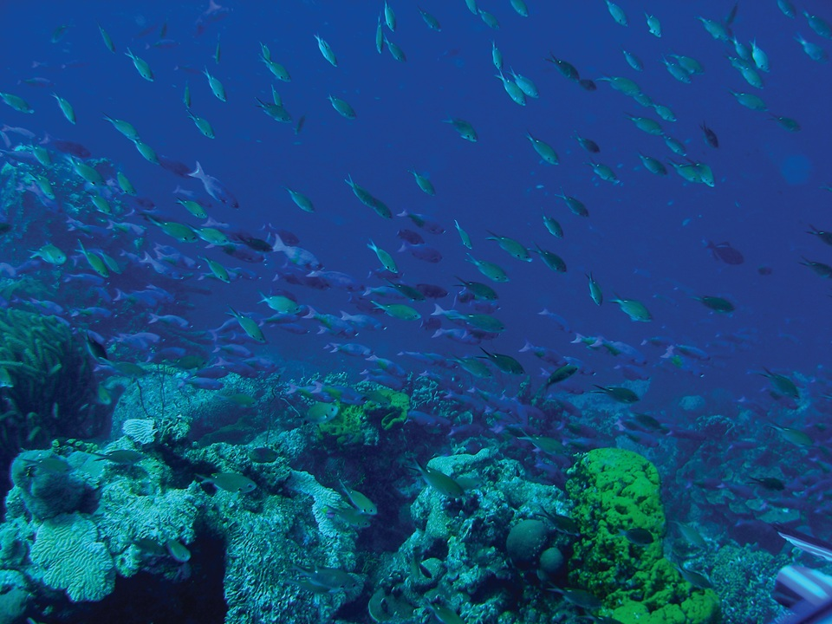

THE BLUE ECONOMY
Team: Pozdrav!
Alexandra Laleva, Reneta Topalksa,
Kristian Neikov
The Gallery of the economy

Slide 2



WHAT IS THE GALLERY ABOUT?

Slide 3
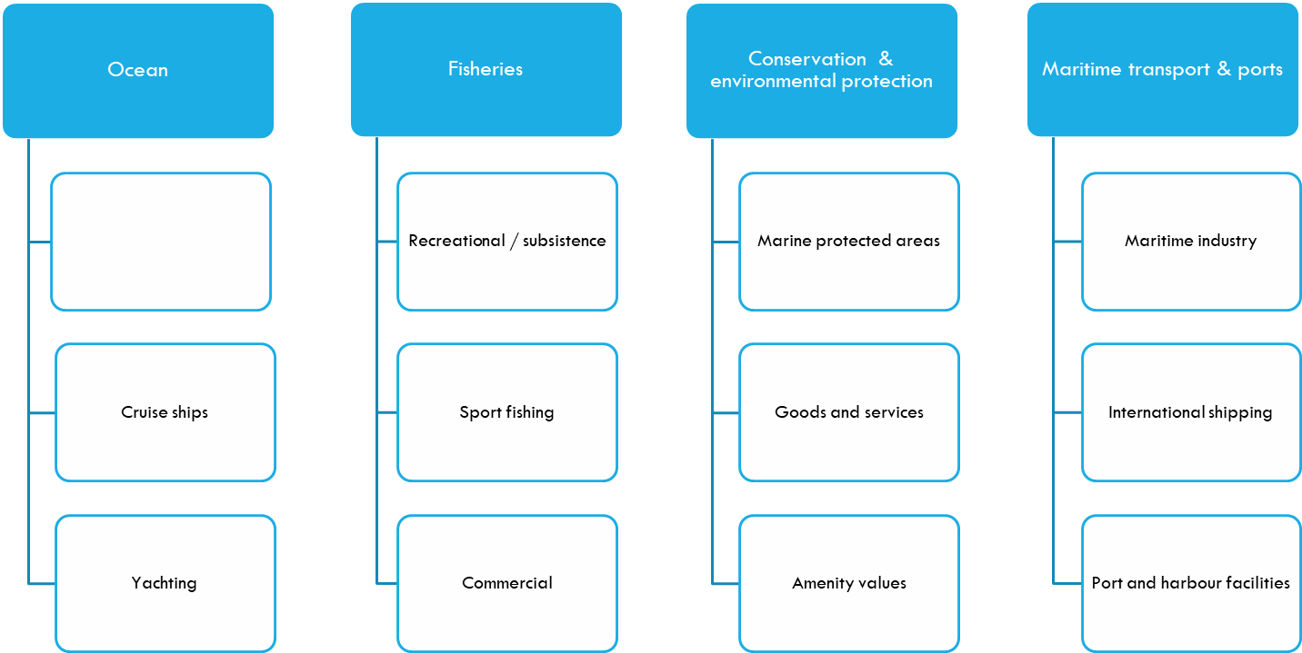
WHAT IS THE GALLERY ABOUT?

Slide 4
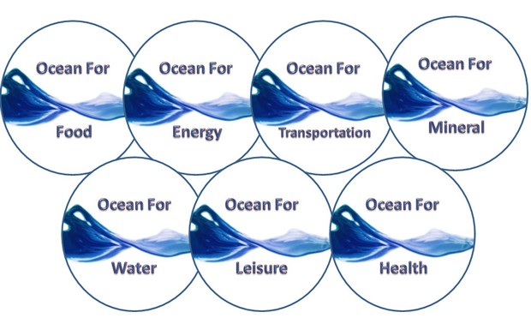
WHAT IS THE BLUE ECONOMY ABOUT?

Slide 5
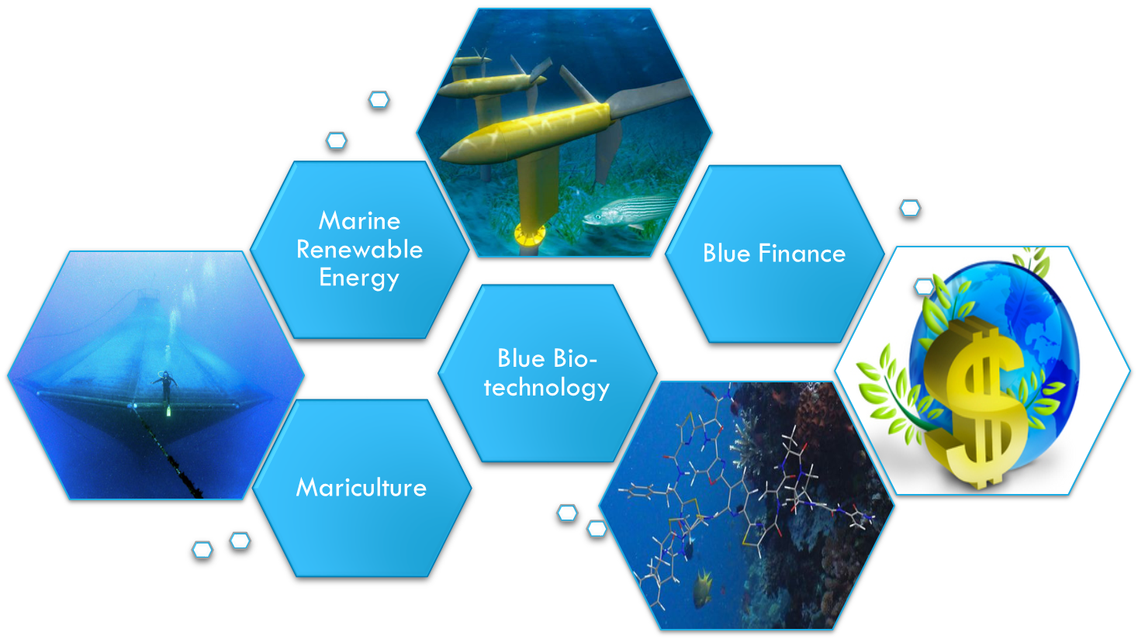
FUTURE BLUE GROWTH OPPORTUNITIES

